Slide 1
Applications of Trees
We will discuss some problems that can be studied using trees. The problems are:
1.How should items in a list be stored so that an item can be easily located?
2.What series of decisions should be made to find an object with a certain property in a collection of objects of a certain type?

Slide 2
Binary Search Tree
Searching for items in a list is one of the most important tasks that arises in computer science.
Our primary goal is to implement a searching algorithm that finds items efficiently when the items are totally ordered.
This can be accomplished through the use of a binary search tree.
Link:https://www.youtube.com/watch?v=ZAMnFOg7dYg
Link:https://www.youtube.com/watch?v=FvdPo8PBQtc

Slide 3
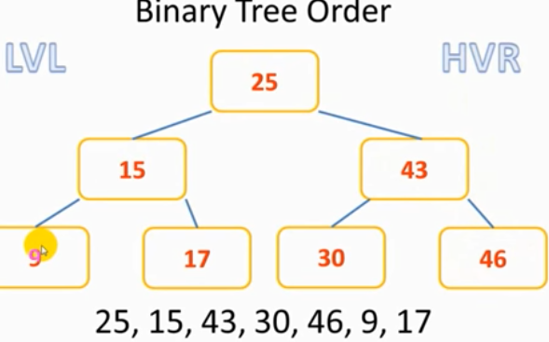

Constructing Binary search tree
Lower value left
Higher value right
Sorted result:
Link:https://www.youtube.com/watch?v=dbvVv7R3TMs

Slide 4
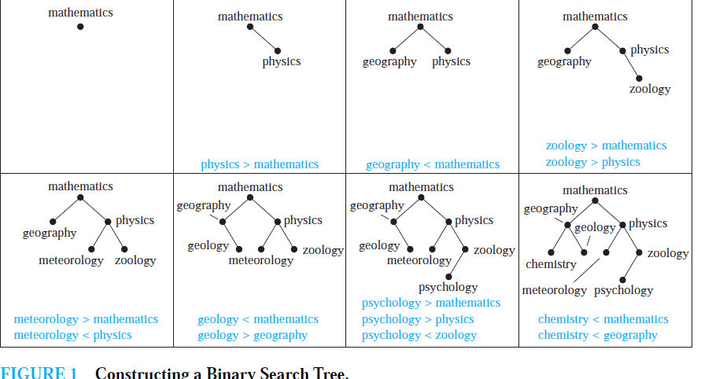
Constructing Binary search tree

Slide 5
Task 1
1. Build a binary search tree for the words banana, peach, apple, pear, coconut, mango, and papaya using alphabetical order.
2. Build a binary search tree for the words oenology, phrenology, campanology, ornithology, ichthyology, limnology, alchemy, and astrology using alphabetical order.

Slide 6
Decision tree
A rooted tree in which each internal vertex corresponds to a decision,with a subtree at these vertices for each possible outcome of the decision, is called a decision tree.
A binary search tree can be used to locate items based on a series of comparisons, where each comparison tells us whether we have located the item, or whether we should go right or left in a subtree.

Slide 7
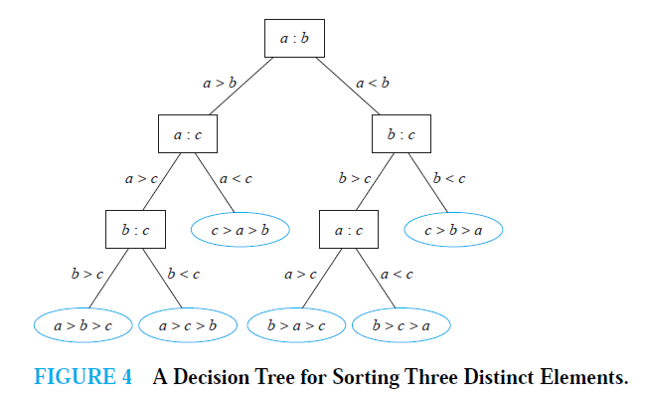
Example: decision tree orders the elements of the list a, b, c.

Slide 8
Game trees
Trees can be used to analyze certain types of games such as tic-tac-toe, nim, checkers, and chess.
In each of these games, two players take turns making moves.
Each player knows the moves made by the other player and no element of chance enters into the game.We model such games using game trees

Slide 9
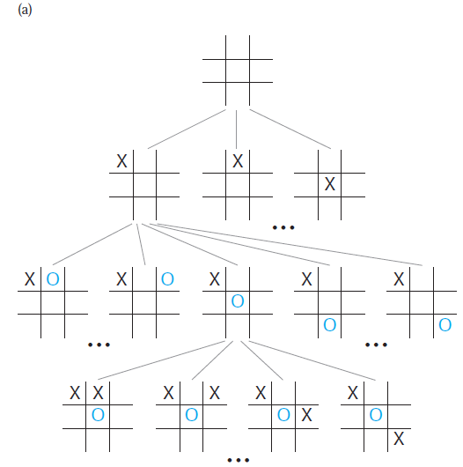
Tic-tac-toe

Slide 10
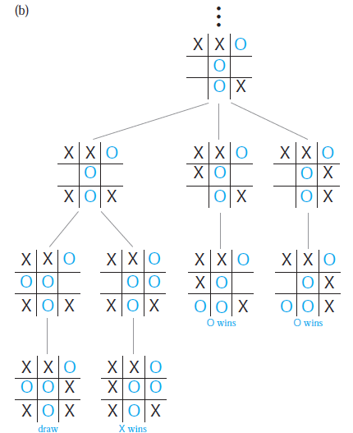
Tic-tac-toe

Slide 11
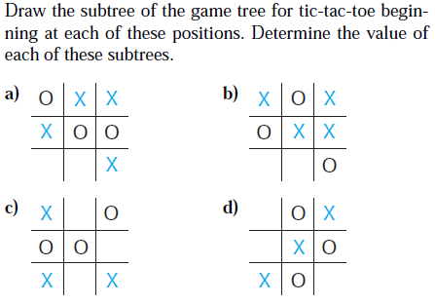
Task 2

Slide 12
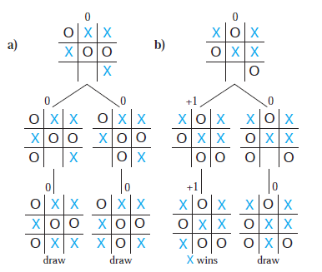
Solution
Link: https://www.youtube.com/watch?v=0SxPMl5AuiM

Slide 13
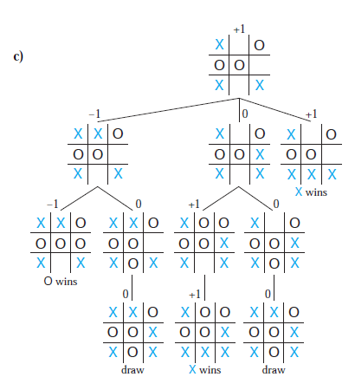
Solution

